Slide 1


DEPARTMENT OF COMPUTER SCIENCE AND ENGINEERING
Face detection and recognition for criminal identification system
TEAM MEMBER:
RAHESH S(113320104074)
PRAVEEN M (113320104072)
MUTHUVEL M K(113320104065)
PROJECT GUIDE:
Mr. V. MANICKAVASAGAN M.E.,
BATCH : 10

Slide 2
CONTENTS
Abstract
Introduction
Existing Systems
Proposed System
Architecture Diagram
Literature Review
Modules and Explanation
Hardware Requirements
Software Requirements
Implementation
Advantages
Conclusion
Future Enhancement
References

Slide 3
ABSTRACT
The process of identifying and spotting a criminal is slow and difficult. Criminals, these days are getting smarter by not leaving any form of biological evidence or fingerprint impressions on the crime scene. A quick and easy solution is using state-of-the-art face identification systems.
With the advancement in security technology, CCTV cameras are being installed at most of the buildings and traffic lights for surveillance purposes. The video footage from the camera can he used to identify suspects, criminals, runaways, missing persons etc. This paper explores a way to develop a criminal identification system using ML and deep neural networks. The following method can be used as an elegant way to make law enforcement hassle-free.
We all know that our Face is a unique and crucial part of the human body structure that identifies a person. Therefore, we can use it to trace the identity of a criminal person. With the advancement in technology, we are placed CCTV at many public places to capture the criminal's crime.

Slide 4
INTRODUCTION
Throughout the years, tracking down a criminal has been a difficult process. Earlier, the entire method consisted of leads based on evidence found on the crime scene. Biological evidence can be easily tracked down. However, criminals have evolved and are smarter than ever in terms of covering tracks and not leaving behind any kind of traceable evidence.
Face recognition and detection come into play here. The face is significant for human identity and due to its distinguishable nature, every face is unique. Face recognition for criminal identification is one of a kind biometric technique that possesses the merit of high accuracy and low intrusiveness. It is a technique that uses the person's face to automatically detect and verify their identity from video frames or images.

Slide 5
EXISTING SYSTEM
Detection of Crimes and its respective Criminals is slower process and it divides into three phases,
The discovery that a crime has been committed.
The identification of a suspect.
The collection of sufficient evidence to indict the suspect.
Forensic science plays an important role in the investigation of serious crimes. One of the first significant achievements in the field was the development of techniques for identifying individuals by their fingerprints.

Slide 6
PROPOSED SYSTEM
In this paper, we are Using CCTV cameras which are continuously working in a public place. In the Implementation of the system, we already saved criminal's images data with their names on photographs in the database. We are processing those images and extracting features from them and in feature extraction; we are taking the face encodings of the present images and saving them into one file using Pickle.
Using open-CV while capturing the footage in CCTV and captured images face encodings taken placed and comparing with our saved face encodings of the criminal database if any match is found then automatically on screen it will display an image of that criminal whose face matches and display the message with his name that criminal found, and his captured image will be saved into special folder police will go and catch him from that public place even if he once captured in the CCTV footage

Slide 7
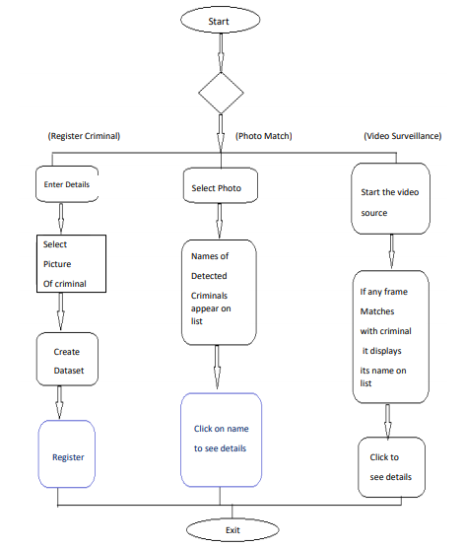
ARCHITECTURE DIAGRAM

Slide 8
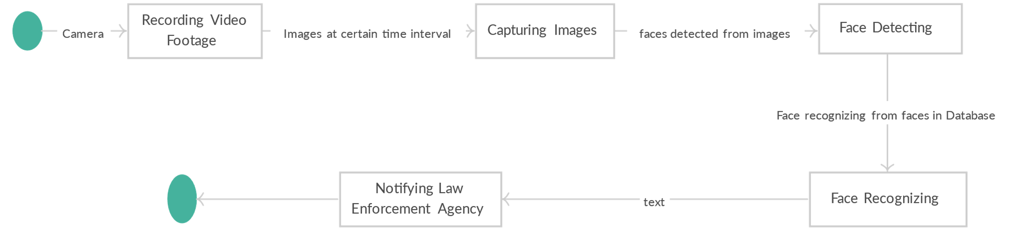
UML DIAGRAM
State diagram

Slide 9
LITERATURE SURVEY
Title : : Face Detection and Recognition System using Digital Image Processing
Authors Gurlove Singh and Amit Kumar Goel
Year: 2020
Description:
While recognizing any individual, the most important attribute is face. It serves as an individual identity of everyone and therefore face recognition helps in authenticating any person's identity using his personal characteristics. The whole procedure for authenticating any face data is sub-divided into two phases, in the first phase, the face detection is done quickly except for those cases in which the object is placed quite far, followed by this the second phase is initiated in which the face is recognized as an individual. Then the whole process is repeated thereby helping in developing a face recognition model which is considered to be one of the most extremely deliberated biometric technology.

Slide 10
Title :Face Detection and Recognition Using OpenCV
Authors: Madhura Mahajan, KTV Reddy, Manita Rajput
Year: 2018
Description:
Face detection and picture or video recognition is a popular subject of research on biometrics. Face recognition in a real-time setting has an exciting area and a rapidly growing challenge. Framework for the use of face recognition application authentication. This proposes the PCA (Principal Component Analysis) facial recognition system. The key component analysis (PCA) is a statistical method under the broad heading of factor analysis. The aim of the PCA is to reduce the large amount of data storage to the size of the feature space that is required to represent the data economically. The wide 1-D pixel vector made of the 2-D face picture in compact main elements of the space function is designed for facial recognition by the PCA

Slide 11
MODULES
Image and video acquisition :
This module is responsible for acquiring and preprocessing images and video feeds from various sources such as cameras, videos, or images. It may also include functionalities like image resizing, rotation, and filtering to improve the quality of the input data.
Face detection :
This module is responsible for detecting and localizing faces in the acquired images or video feeds. It typically uses algorithms like Haar cascades or deep learning-based approaches like Convolutional Neural Networks (CNNs) to detect faces.

Slide 12
Face alignment:
This module is responsible for aligning the detected faces to a canonical pose. It corrects for factors like facial pose, rotation, and illumination, which can affect the accuracy of face recognition.
Feature extraction:
This module is responsible for extracting discriminative features from the detected and aligned faces. Common feature extraction techniques include Principal Component Analysis (PCA), Local Binary Patterns (LBP), and Histogram of Oriented Gradients (HOG).
Face recognition:
This module is responsible for comparing the extracted features of the detected faces with a database of known faces to identify potential matches. It typically uses algorithms like Euclidean distance or Support Vector Machines (SVM) to compare the features.

Slide 13
Database management:
This module is responsible for managing the database of known faces, including adding, deleting, and updating records.
Alert generation:
This module is responsible for generating alerts and notifications when a match is found between a detected face and a known criminal in the database
System management:
This module is responsible for managing the overall system, including configuring system settings, monitoring system performance, and handling system errors and exceptions.These modules work together to create a robust and reliable face detection and recognition system for criminal identification.

Slide 14
COMPONENTS REQUIRED
Hardware Requirements:
4GB RAM (Minimum).
80GB HDD.
Dual Core Processor.
Camera (Webcam/CCTV).
VGA (Video Graphics Array) Resolution monitor
Software Requirements:
Microsoft Windows 10 (or) Higher.
Python 3.5+.
OpenCV 4.4.0.40.
SQLite Studio.

Slide 15
IMPLEMENTATION
Algorithm: After preparing the dataset, the machine learning algorithm will get the data. Data analysis and DDOS attack type prediction are done using machine learning algorithms. Unpredictable Forest Classifier Combining the decision tree with a random forest algorithm. In comparison to other classification, it is extremely quick. The machine learning classification model is now the next stage following feature scaling. A random forest classification technique was employed in the suggested work. Many decisions in the suggested model are made using the random forest, one of the most well-liked and effective machine learning classification methods. Both the Random Forest Precision (PR) and Recall (RE) were found to be roughly 89% accurate in the initial classification.
The XGBoost algorithm is regarded by academic and scientific researchers as the queen in the age of machine learning and artificial intelligence. The majority of researchers think of it as a tool for using huge data. This model uses trees as well, however it does it 100 times more quickly than other models. The XGBoost learning model is extremely quick, scalable, effective, and straightforward. For massive data, this model is more dependable. This model uses probability to operate. The confusion matrix and classification results for the XGBoost algorithm are provided below. The accuracy of XGBoost Precision (PR) and Recall (RE) is about 90%. We observed an average Accuracy Algorithm of about 90%.

Slide 16
ADVANTAGES
It is approximately100 times faster than the random forest and best for forbid data analysis.
Both are simple and faster than other algorithm in terms of execution times.

Slide 17
CONCLUSION
This paper presents an innovative approach to face recognition and how it can be implemented for an important purpose which is Criminal Detection and identification. Face Recognition technologies have a wide range of applications, similar approaches can be used for solving a lot of real-world problems.
We believe developing a system as such is an enthusiastic step towards making the process of catching criminals and law enforcement speedy and efficient. This system can be further implemented to criminals in real-time using a dynamic dataset. Application of computer vision can be challenging but create solutions to difficult problems easier.

Slide 18
FUTURE ENHANCEMENT
An elegant face identification system like this can be automated to detect criminals through CCTV cameras installed at multiple places.
This system can also be used to detect missing people at time of disasters and mis-happenings.
Criminal Identification system can also give details of where the criminals was exactly spotted using location of cameras

Slide 19
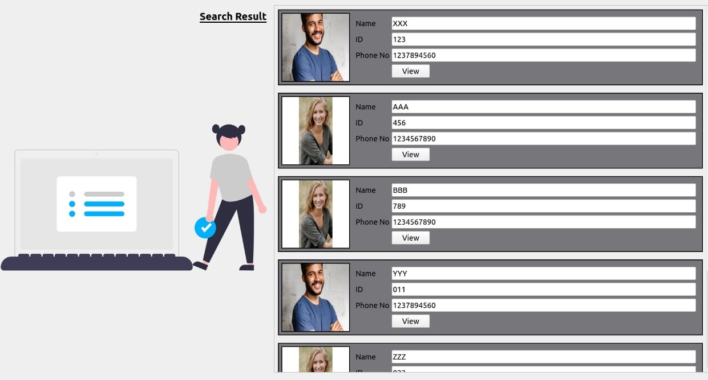
SCREENSHOT

Slide 20


Slide 21
REFERENCE
[1] P. M. Corcoran and C. lancu, "Automatic face recognition system for hidden markov model techniques," New Approaches to Characterization and Recognition of Faces, pp. 3-28, 2011.
[2] Bledsoe, "Manual measurements", 1960.
[3] A.J. Goldstein, L.D. Harmon and A.B. Lesk, "Identification of human faces, "in proceedings of the IEEE, vol 59, pp. 748-760, May 1971.
[4] LSirovich and M.Kirby, "Low dimensional procedure for the characterisation of human faces," in Journal of the Optical Society of America A, vol 4, pp. 519-524, 1987
[5] M. Turk and A. Pentland, "Eigenfaces for Recognition," in Journal of cognitive neuroscience, vol 3, pp. 71-86, Jan 1991.

Slide 22
THANK YOU

